Slide 1


Ethics in Data Privacy Abuse by Tech Giants
Group Members:
Fazle Rabby (221002378)
Md Tanvir Molla (221002179)
Tuhin Mahmud (213002242)
MD Arman Hossain Shakib Talukder (221902261)
MD Ahashan Habib Shekh Jibon (222002008)
A S M Kamrul Islam
Lecturer, Department of CSE
Green University of Bangladesh

Slide 2


The Case Study:
In 2018, it was revealed that political consulting firm Cambridge Analytica had harvested the personal data of millions of Facebook users without their consent.
This incident is a prime example of Data Privacy Abuse in the tech sector, highlighting the ethical failures in protecting user autonomy.
09-12-2025
1

Slide 3






The Unethical Practice
The "Research" App
The Loophole
Commercial Sale
09-12-2025
2

Slide 4

Psychographic Profiling
The core unethical act was using harvested data to build "Psychographic Profiles" based on the Big Five personality traits:
Openness
Conscientiousness
Extroversion
Agreeableness
Neuroticism
09-12-2025
3

Slide 5
Scale of the Abuse
87M
5000
$5B
USERS AFFECTED
DATA POINTS PER PERSON
FTC FINE TO FACEBOOK
09-12-2025
4

Slide 6
Academic Theory: Deontology
“
"Act in such a way that you treat humanity, whether in your own person or in the person of any other, never merely as a means to an end, but always at the same time as an end."
— Immanuel Kant (Critique of Practical Reason)
09-12-2025
5

Slide 7
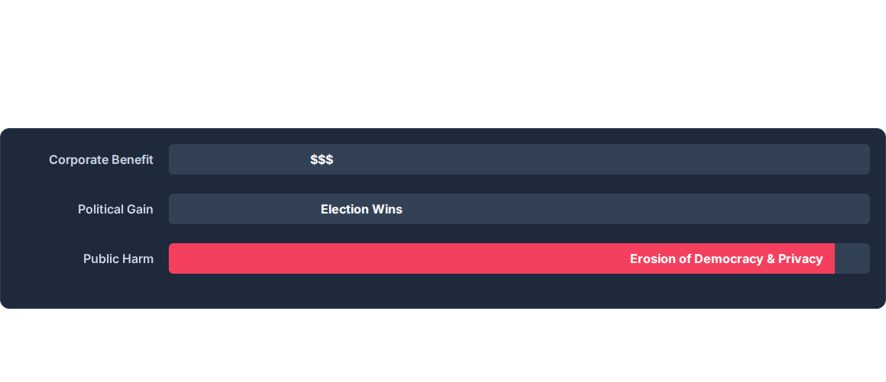
Academic Theory: Utilitarianism
A Utilitarian Cost-Benefit Analysis reveals a massive ethical failure. The net utility is overwhelmingly negative.
09-12-2025
6

Slide 8

Proposed Solutions
09-12-2025
7

Slide 9
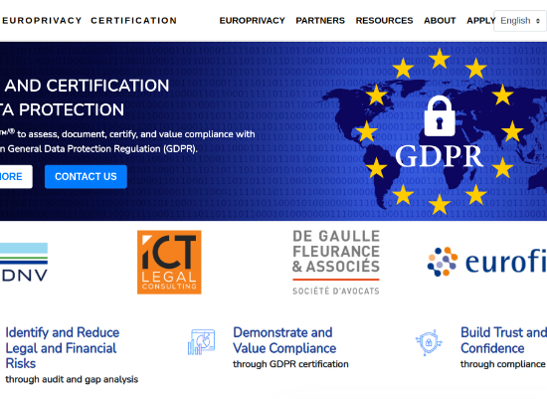
Regulatory Solution: GDPR
Stricter Compliance
Enforce frameworks like the General Data Protection Regulation (GDPR) globally.
Informed Consent
Purpose Limitation
Right to Erasure
09-12-2025
8

Slide 10
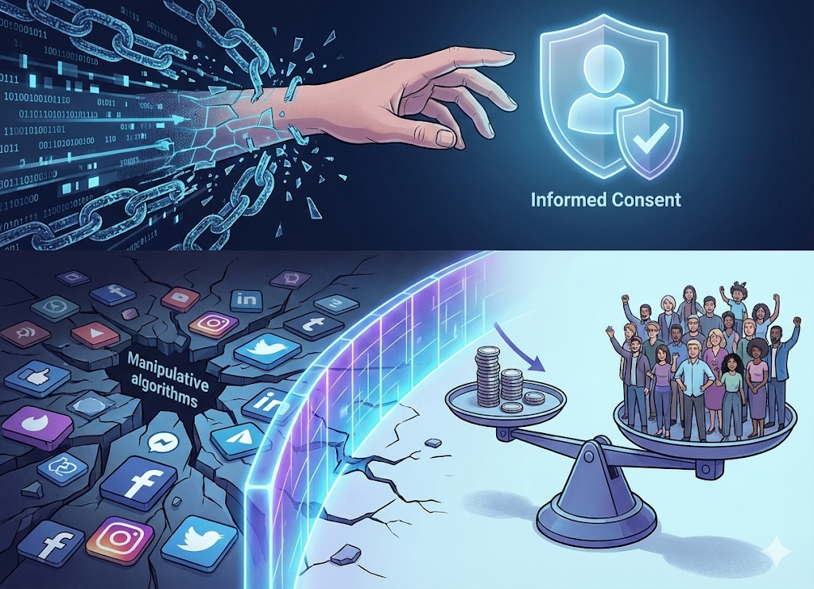
Justifying the Solution
Restoring Autonomy
By mandating Informed Consent (Regulatory), we restore the Kantian ideal of treating users as ends. They regain control over their digital identity.
Minimizing Harm
From a Utilitarian perspective, these solutions reduce the massive social harm of manipulation. While corporate data profits may decrease, the preservation of democratic integrity maximizes overall societal well-being.
09-12-2025
9

Slide 11
Questions?
Thank you for your attention.
09-12-2025
10

